Slide 1
COOLING CONTROLLERS
REFRIGERATION
HEATING
Electronic thermostat GC202
APPLICATION
GC202s are used in cabinets, display cases and shelves operating in both low and high temperature ranges. They replace the G-202-P00 controller.
When used in cooling and freezing cabinets, a door opening sensor can be connected, which fully controls the operation of the fan and light compressor depending on the time the door is opened.
In devices of low, medium and high power (230V) it allows connecting all devices controlled by it (compressor, heater, fan and light) directly to the controller, without the need for additional contactors. This is possible thanks to the use of 16A and 30A relays.
It is also manufactured in versions with three temperature sensors and in simplified versions with a smaller number of outputs.
PROPERTIES
■ Built-in ON/OFF switch
■ Control panel operating under safe 5V voltage
■ 230V power supply (built-in transformer) of the executive module
■ Four 230V relay outputs
■ Two temperature sensors and a door opening sensor operating at a safe voltage of 5V
■ Programmable control of the compressor, light and fan from the door opening sensor
■ Automatic evaporator defrost
■ Direct light and defrost buttons
■ Signalling of compressor operation and the entire defrosting process
■ Signalling (optical and sound) of damage in sensor circuits and emergency operation
■ Possibility of programming and monitoring by computer
TECHNICAL DATA
EXIT | RELAY | MAXIMUM CONTINUOUS LOAD
P1 – Light | 8A | 4A | 750W | -
P2 – Fan | 16A | 4A | 750W | 1HP
P3 – Heater / Valve | 8A | 8A | 1500W | -
P4 – Compressor | 30A | 8A | 1500W | 2HP
Operating voltage | ~230V AC +10% / -15%
Operating temperatures | +5ºC to +40ºC
Humidity | From 20% to 80% RH
Ingress protection | IP65 From the front side of the control panel
Sensor type | T1: NTC – range: -40°C to +60°C T2: NTC – range: -40°C to +60°C
Door opening sensors manufactured by GECO
Optical: CZ-OPO-M12-NC-2.5M-TE05-1
Magnetic: CTC100-2-2.0M-TE05
Any other O/I sensors
P.P.U.H. GECO Sp. z o.o.
Cholerzyn 376
32-060 Liszki, Poland
Phone +48 (12) 636 98 11, 636 12 90, +48 (602) PPGECO
Fax +48 (12) 636 20 02
E-mail: geco@geco.pl, http://www.geco.pl

Slide 2
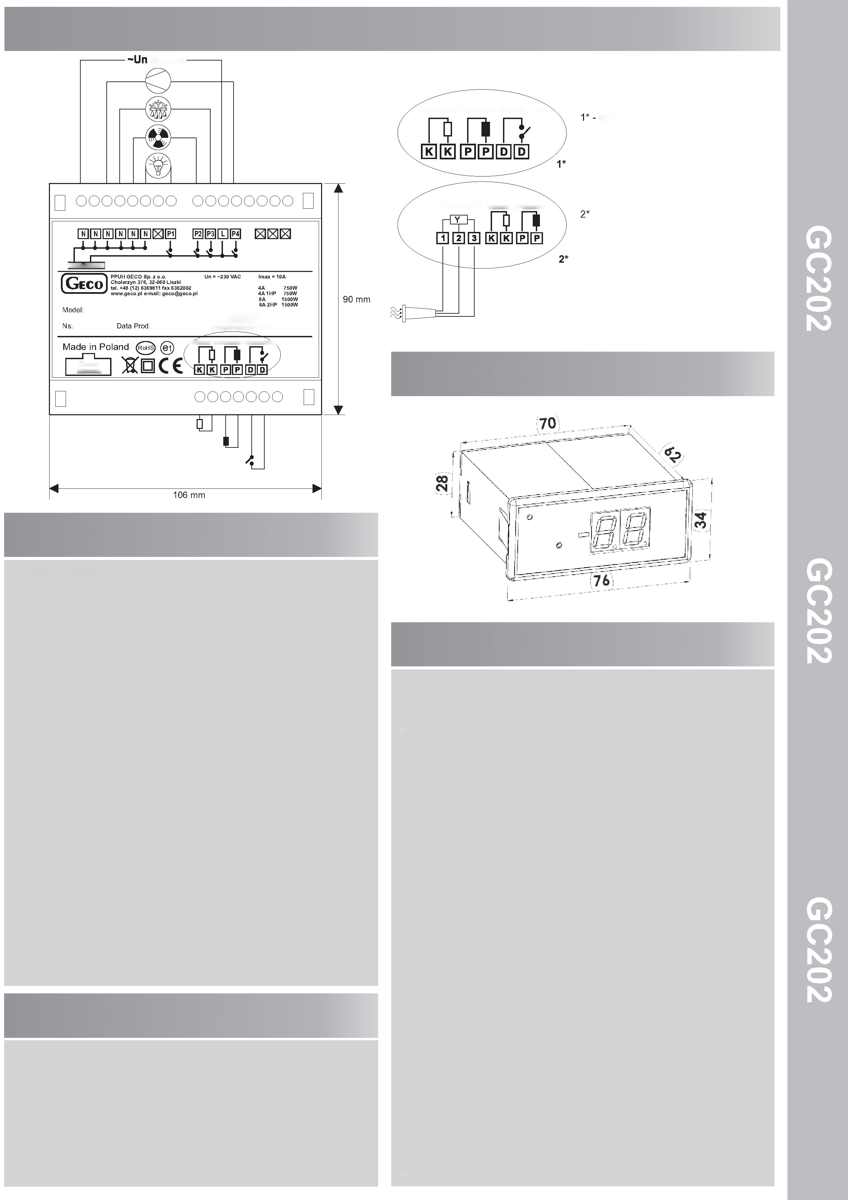
WIRING DIAGRAM
Power supply
TEMPERATURE SENSORS
DOOR SENSOR
version with a mechanical door opening sensor: GC202.01, GC202.02
OPTICAL SENSOR
TEMPERATURE SENSORS
- version with optical door opening sensor: GC202.03
Door sensor:
1 – OUT – black
2 – GND – blue (previously white)
3 – +12V – brown (previously red)
CONTROL
P1 – Light
P2 – Fan
P3 – Heater
P4 – Compressor
P-P EVAPORATOR sensor – GRAY
K-K CHAMBER sensor – WHITE
D-D Door Open Sensor
Ribbon Connector
TEMPERATURE SENSORS
DOOR SENSOR
HOUSING DIMENSIONS
K-K CHAMBER sensor
P-P EVAPORATOR sensor
D-D Door Open Sensor
METHOD OF MARKING
Model designation: GC202.0X
0X – number denoting the version of the driver
01 – 3-relay controller controlling the following devices:
compressor/fan/heater or valve.
Controller panel keyboard is made without the light button.
The standard DD input allows connecting an additional sensor, the selection of which depends on the r6 parameter. Depending on the setting of this parameter, we can connect a door opening (mechanical or magnetic) sensor or an additional temperature sensor acting as a thermometer (for r6=3).
02 – 4-relay controller controlling the following devices:
compressor/light/fan/heater or valve.
The keyboard of the controller panel is made with a light button. The standard DD input allows the connection of an additional sensor, the selection of which depends on the r6 parameter. Depending on the setting of this parameter, we can connect a door opening (mechanical or magnetic) sensor or an additional temperature sensor acting as a thermometer (for r6=3).
03 – 4-relay controller controlling the following devices:
compressor/light/fan/heater or valve.
Controller panel keyboard made with light button. The standard mounted input 1-2-3 allows connecting an additional sensor, the selection of which depends on the r6 parameter. Depending on the setting of this parameter, we can connect an optical door opening sensor or an additional temperature sensor acting as a thermometer (for r6=3).
DRIVER DESCRIPTION
GC202 is a universal controller for refrigeration devices operating in various temperature ranges.
GC202 stabilizes the temperature in the chamber with a compressor. Compressor control includes protection against too frequent switching on or off.
The device enters the automatic evaporator defrosting mode at specified intervals.
Depending on the programming of the controller, defrosting has a different course, e.g. after the end of defrosting, the dripping phase is followed by the freezing phase.
GC202 has a button to activate defrosting, this is used in the case of severe operating conditions of the device.
Automatic defrosting is the same as manual defrosting.
The controller has an off button. When the device is turned off, the compressor, heater and fan are turned off.
The button and the light relay operate independently of the off button.
Opening the door turns on the light, turns off the fan, after a minute the compressor stops.
The opening of the door is signalled with a sound every 30 seconds. An alarm is triggered if the door is opened too long.
The user programs the set temperature in the chamber.
The GC202 displays the temperature measured by the chamber sensor. The user can enable a temporary view of the temperature of the evaporator sensor.
In the event of a sensor failure, the controller displays an alarm code and operates in emergency mode.
The controller has internal service parameters that determine the way it functions. The parameters can be programmed after entering the controller in a special mode, or by means of a computer.
GC202 has a connector for communication with a computer. It is possible to monitor both a single thermostat and the entire network together with other Geco controllers.
COMPOSITION OF THE SET
Thermostat:
• Control Panel
• Executive module
• Ribbon connecting the executive module and the control panel
• Two temperature sensors of the ordered length.
Additionally, you can order contactless door opening sensors:
• magnetic sensor
• optical sensor

