Slide 1
COOLING CONTROLLERS
REFRIGERATION
HEATING
Electronic regulator GC207
APPLICATION
GC207 is used in cabinets and cold rooms with two compressors, operating at both low and high temperatures. It is a replacement for the G-207-P00 controller.
When used in cooling and freezing cabinets, you can connect a door opening sensor that fully controls the operation of the compressor, fan and light depending on the time the door is opened.
In high-power devices (for 230V), it allows the connection of all controlled devices (compressor, light, fan, heater) directly to the controller, without the need for additional contactors. This is possible due to the use of 16A and 30A relays.
PROPERTIES
■ Built-in ON/OFF switch
■ Control panel operating under safe 5V voltage
■ 230V power supply (built-in transformer) for the executive module
■ Five relay outputs operating at 230V
■ Two temperature sensors and a door opening sensor operating at a safe voltage of 5V
■ Programmable control of compressors, light and fan from door opening sensor
■ Automatic evaporator defrost
■ Direct light and defrost buttons
■ Signalling of compressor operation and the entire defrosting process
■ Signalling (optical and sound) of damage in sensor circuits and emergency operation
TECHNICAL DATA
EXIT | RELAY | MAXIMUM CONTINUOUS LOAD
P1 – Compressor | 30A | 8A | 1500W | 2HP
P2 – Light | 16A | 4A | 750W | -
P3 – Fan | 16A | 4A | 750W | 1HP
P4 – Heater | 16A | 4A | 750W | -
P5 – Compressor | 30A | 8A | 1500W | 2HP
Operating voltage | ~230V AC +10% / -15%
Operating temperatures | +5ºC to +45ºC
Humidity | From 20% to 80% RH
Ingress protection | IP65 at the front of the control panel
Sensor type | NTC – range: -40°C to +60°C
Input | Sensor
P-P | evaporator temperature
K-K | chamber temperature
D-D(Y) | optional magnetic door opening sensor (optical)
P.P.U.H. GECO Sp. z o.o.
Cholerzyn 376
32-060 Liszki, Poland
Phone +48 (12) 636 98 11, 636 12 90, +48 (602) PPGECO
Fax +48 (12) 636 20 02
E-mail: geco@geco.pl, http://www.geco.pl

Slide 2
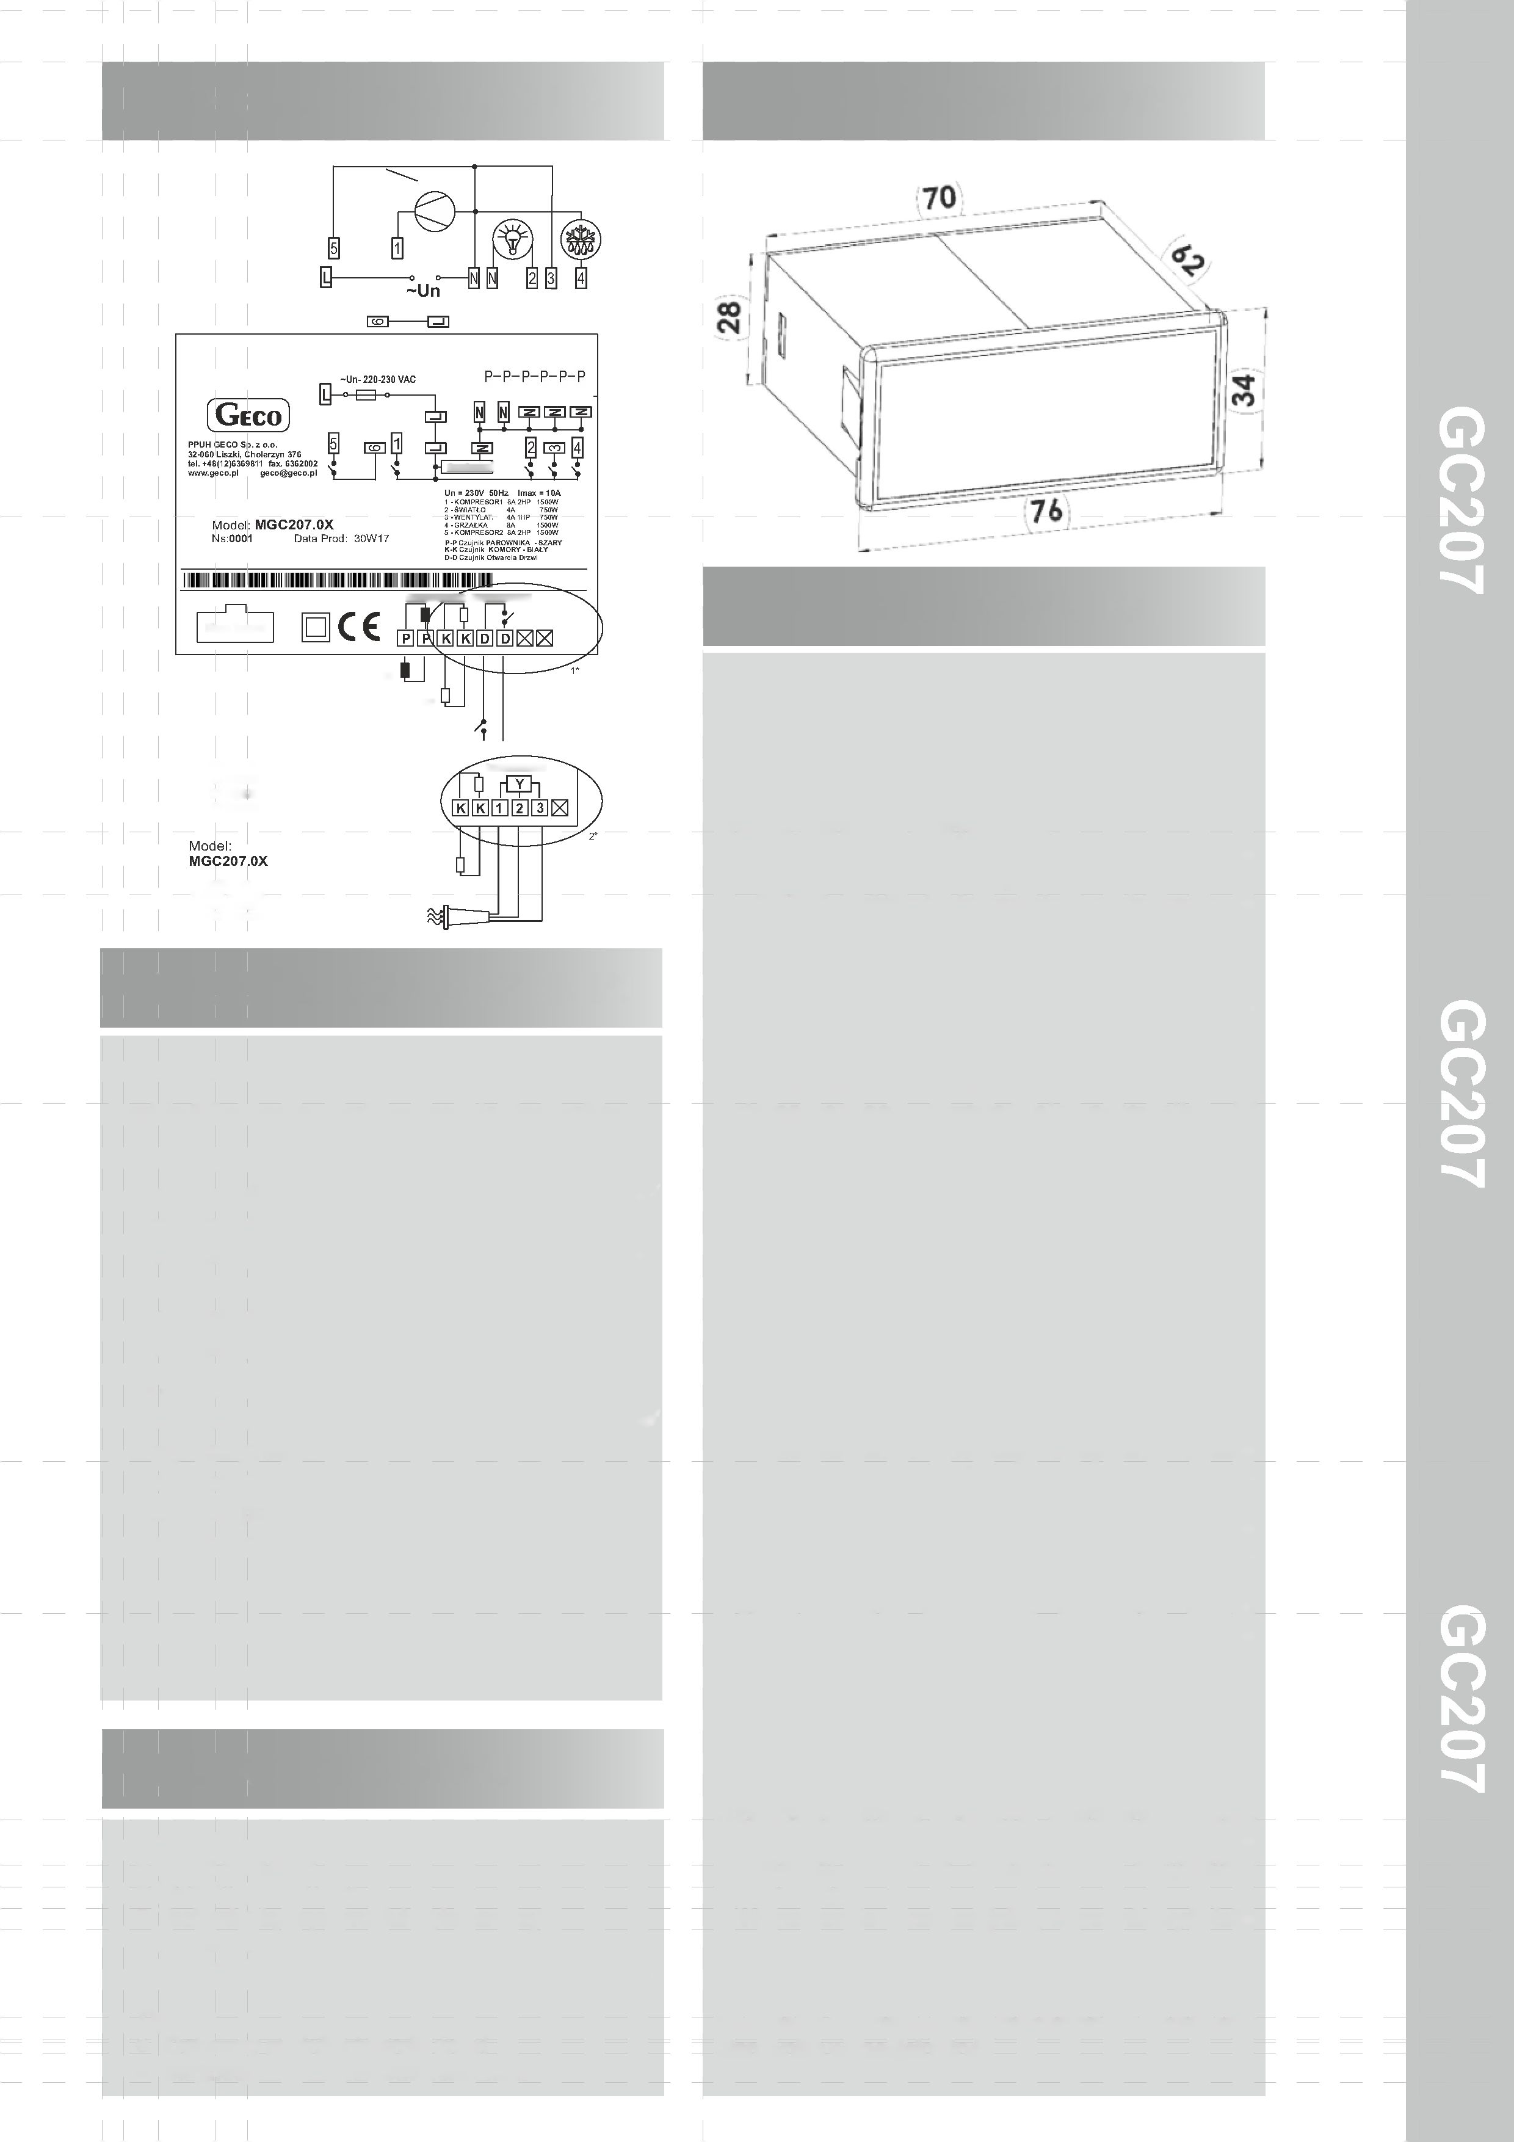
WIRING DIAGRAM
HOUSING DIMENSIONS
DRIVER DESCRIPTION
Ribbon Connector
TEMPERATURE SENSORS
DOOR SENSOR
AND CONTROL
P-P EVAPORATOR sensor
GC207 is a universal controller for refrigeration devices operating in various temperature ranges.
The controller has an on/off function by holding the ON/OFF button for 5 seconds. When the device is turned off, the compressors, heater and fan are turned off.
If the controller has a light function, it works independently of the off button.
GC207 stabilises the temperature in the chamber using compressors. Compressor control includes protection against too frequent switching on or off.
The second compressor starts 6 seconds after the first one. The same relationship occurs when the compressors are switched off.
The device enters the automatic evaporator defrosting mode at specified intervals. Depending on the programming of the controller, defrosting has a different course, e.g. after the end of defrosting, the dripping phase is followed by the freezing phase.
The GC207 has a defrost button. This is used in the case of severe operating conditions of the device.
Automatic defrosting is the same as manual defrosting.
The user programs the set temperature in the chamber.
If a door sensor is connected to the controller, opening the door causes the light to be switched on (depending on the parameter settings), the fan to be switched off, and the compressor to stop after one minute.
The opening of the door is signalled with a sound every 30 seconds. An alarm is triggered if the door is opened too long.
If an additional temperature sensor is connected instead of the door opening sensor, the display shows the indication from this sensor. It does not affect the operation of the device, but only serves as an electronic thermometer.
If the secondary temperature sensor is not supported, the GC207 displays the temperature measured by the room sensor. The user can enable a temporary view of temperatures: from the evaporator sensor and the chamber (in the case of working with an additional temperature sensor).
In the event of a sensor failure, the controller displays an alarm code and operates in emergency mode.
The controller has internal service parameters that determine the way it functions. The parameters can be programmed after entering the controller in a special mode.
K-K CHAMBER sensor
D-D Door Open Sensor
1* – version with a magnetic door opening sensor
2* – version with an optical door opening sensor
DOOR SENSOR
Door sensor:
1 – OUT – black;
2 – GND – white;
3 – + 12V – red;
Optical Door Opening Sensor
METHOD OF MARKING
Model designation: GC207.0X
where 0X means the version of the driver:
02 – 5-relay controller controlling devices: compressor/light/fan/heater or valve/second compressor.
Controller panel keyboard with light button. Possibility of connecting a door opening (mechanical or magnetic) sensor or a temperature sensor acting as a thermometer.
03 – 5-relay controller controlling devices: compressor/light/fan/heater or valve/second compressor.
Controller panel keyboard with light button. Optical door opening sensor or temperature sensor (thermometer) can be connected.
COMPOSITION OF THE SET
Thermostat:
• Control Panel
• Executive module
• Ribbon connecting the executive module and the control panel
• Two temperature sensors of the ordered length.
Options:
• Optical door opening sensor
• Magnetic door opening sensor

